Slide 1
Building Deep Learning Applications Final Project
111c71007 Po Kai Su
111318046 Wei Yi Lin
111318053 Jui Yang Tsai
Professor: K.T. Lai

Slide 2

Video

Slide 3
Outline
Motivation
Requirements
Data Introduction
Multilayer Perceptron Structure
Results
Problems

Slide 4
Motivation
1

Slide 5
Motivation
The webcam people bought during the Covid-19 become useless after Covid.
People stay in front of computers all day and lack exercise.
People gain a lot of stress, a game can help.
This project allows people can do both exercise and gaming in front of their computers using their bought webcam.

Slide 6
Requirements
2

Slide 7
Requirements
Keras 2.9.0
Tensorflow 2.6.0
Matplotlib 3.4.2
MediaPipe 0.8.9.1
Numpy 1.22.3
Pandas 1.3.4
OpenCV-python 4.5.5.62
pygame 2.3.0
CAMERA: Logitech c270
OS: Windows 11 64bits
CPU: AMD Ryzen R9-5900Hs
RAM: 32GB
GPU: Nvidia-RTX3060

Slide 8
Data Introduction
3

Slide 9
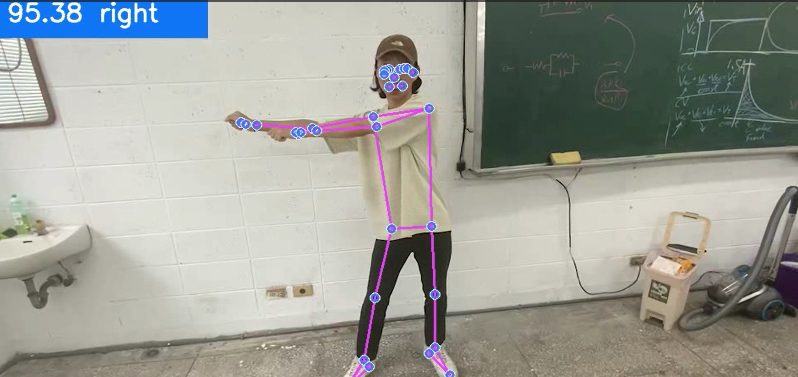
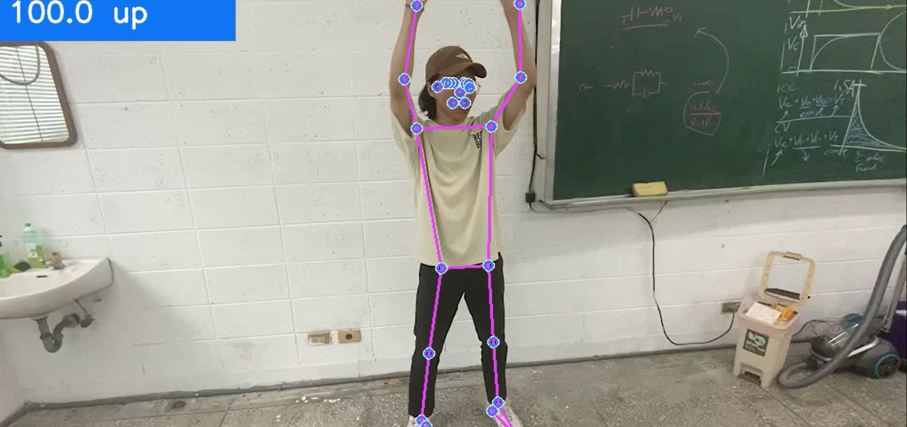
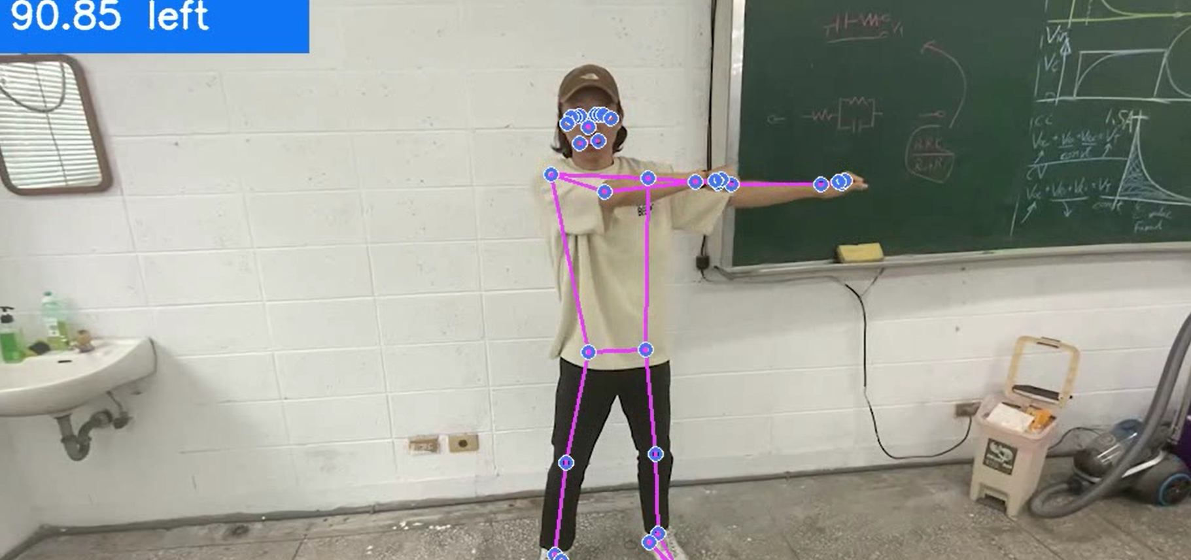
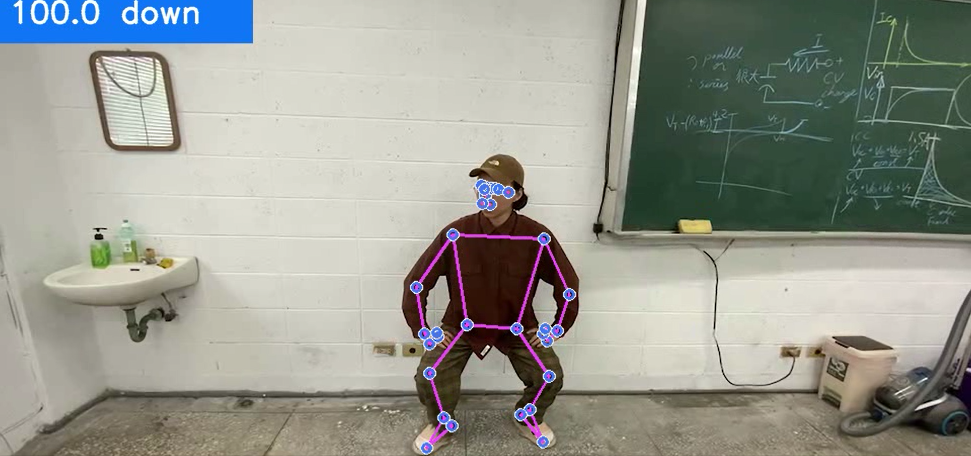
Data Introduction

Slide 10
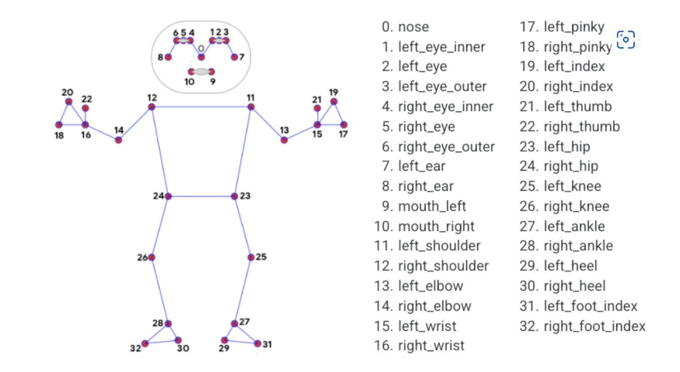
Data Introduction

Slide 11
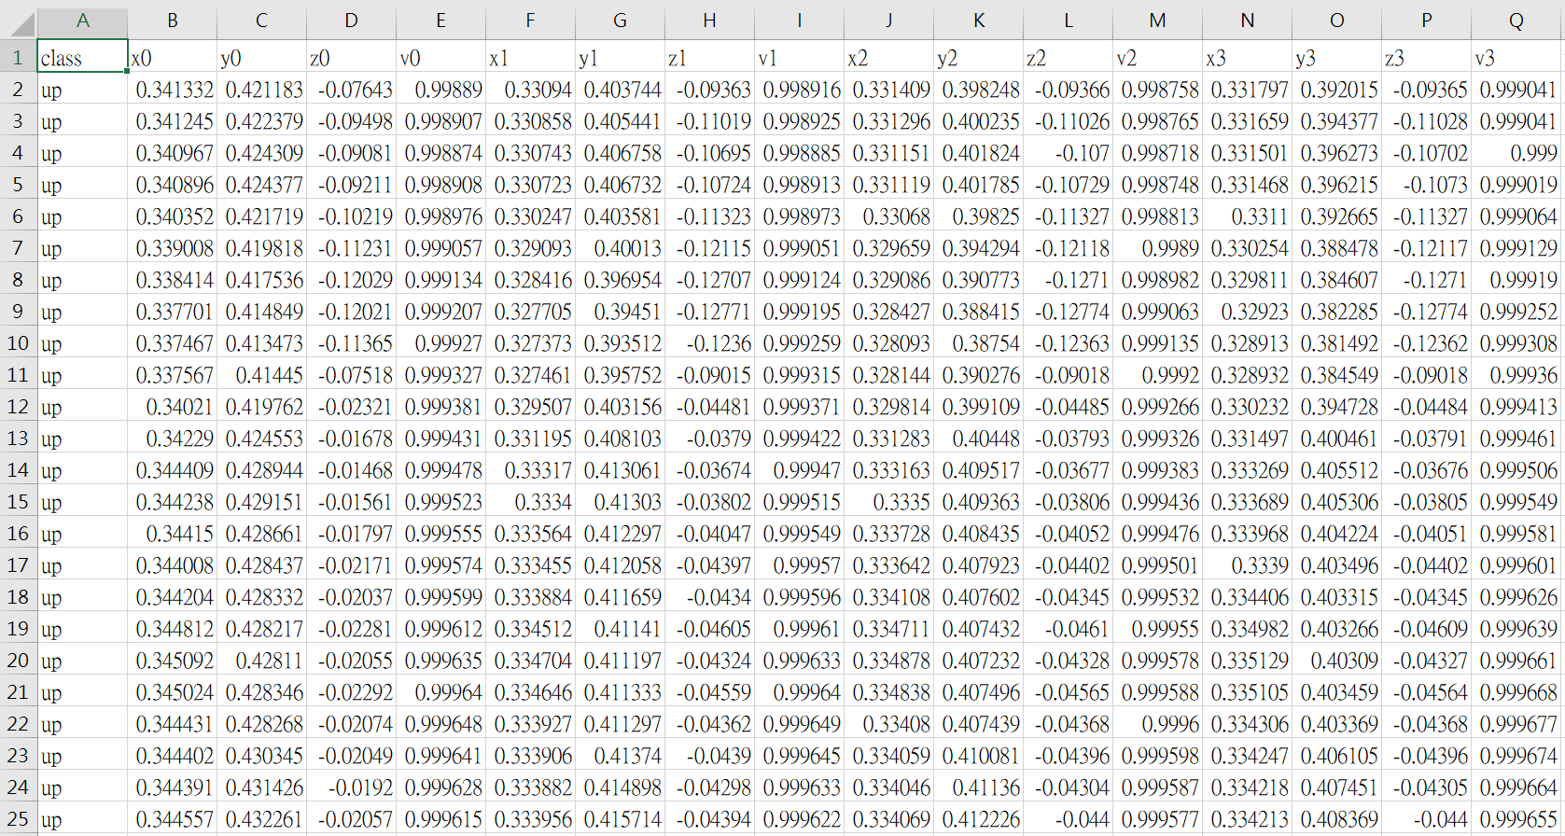
Data Introduction
x, y, z, v(visibility) return from human joints
Labels of gestures

Slide 12
Multilayer Perceptron Structure
4

Slide 13
Structure Introduction
Motion Recording
Motion Prediction
Snake
environment
OpenCV
Video Reading
Save
Model
Weight
Step
Reaction
MediaPipe
get
Coordinate
Coordinate to csv file
MLP Training
Human Reaction

Slide 14
Results
5

Slide 15
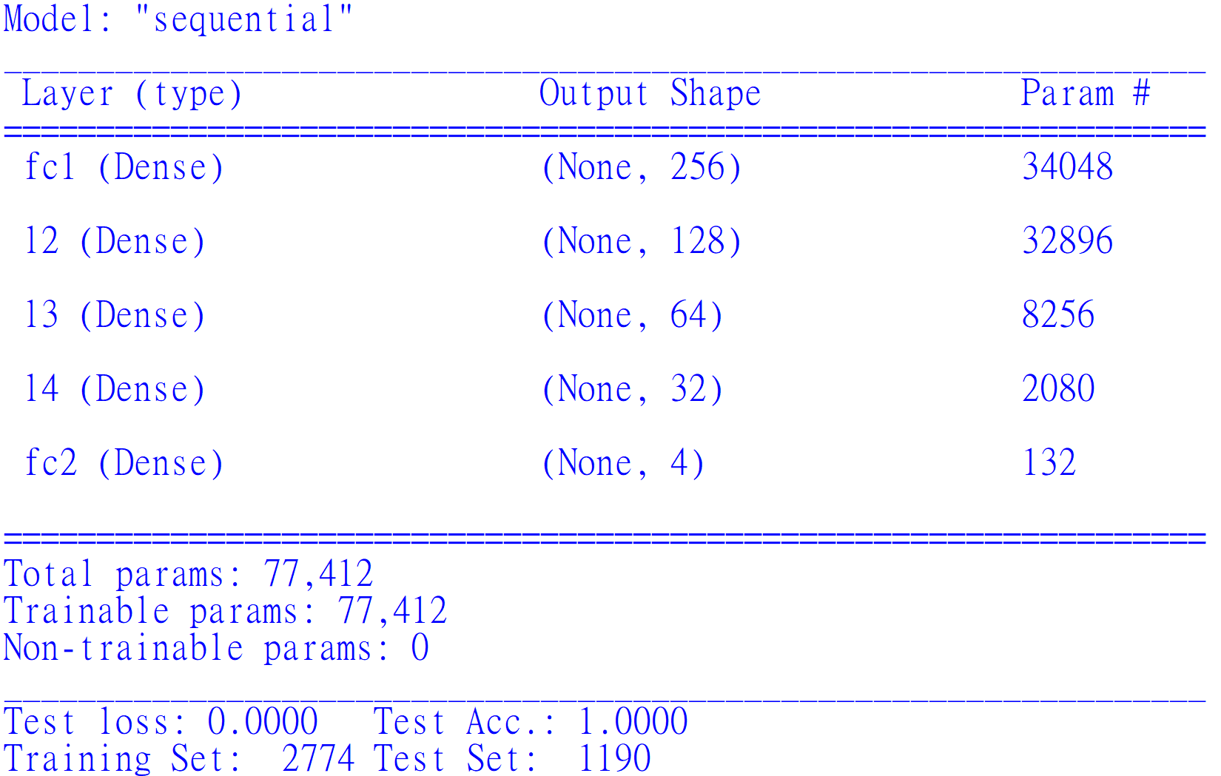
Result (MLP)

Slide 16
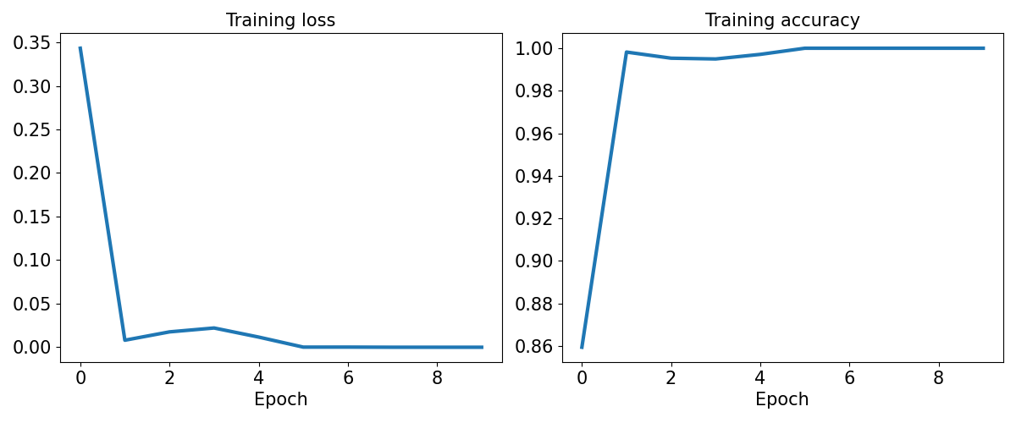
Result (MLP)

Slide 17
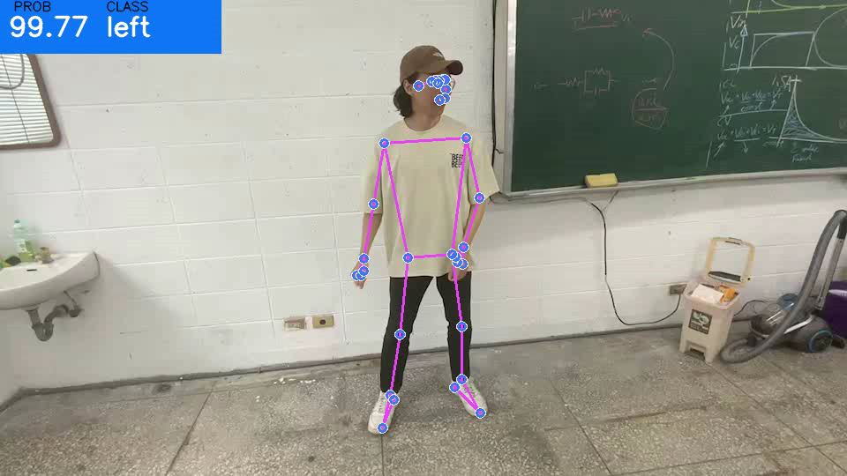
Result

Slide 18
Problems
6

Slide 19

Problems
Only 4 directions data collected (←↑→↓), the transition data between directions are not collected.
FPS drop issue while the real time recognition.
Misdirection issue.
Majority Vote algorithm

Slide 20
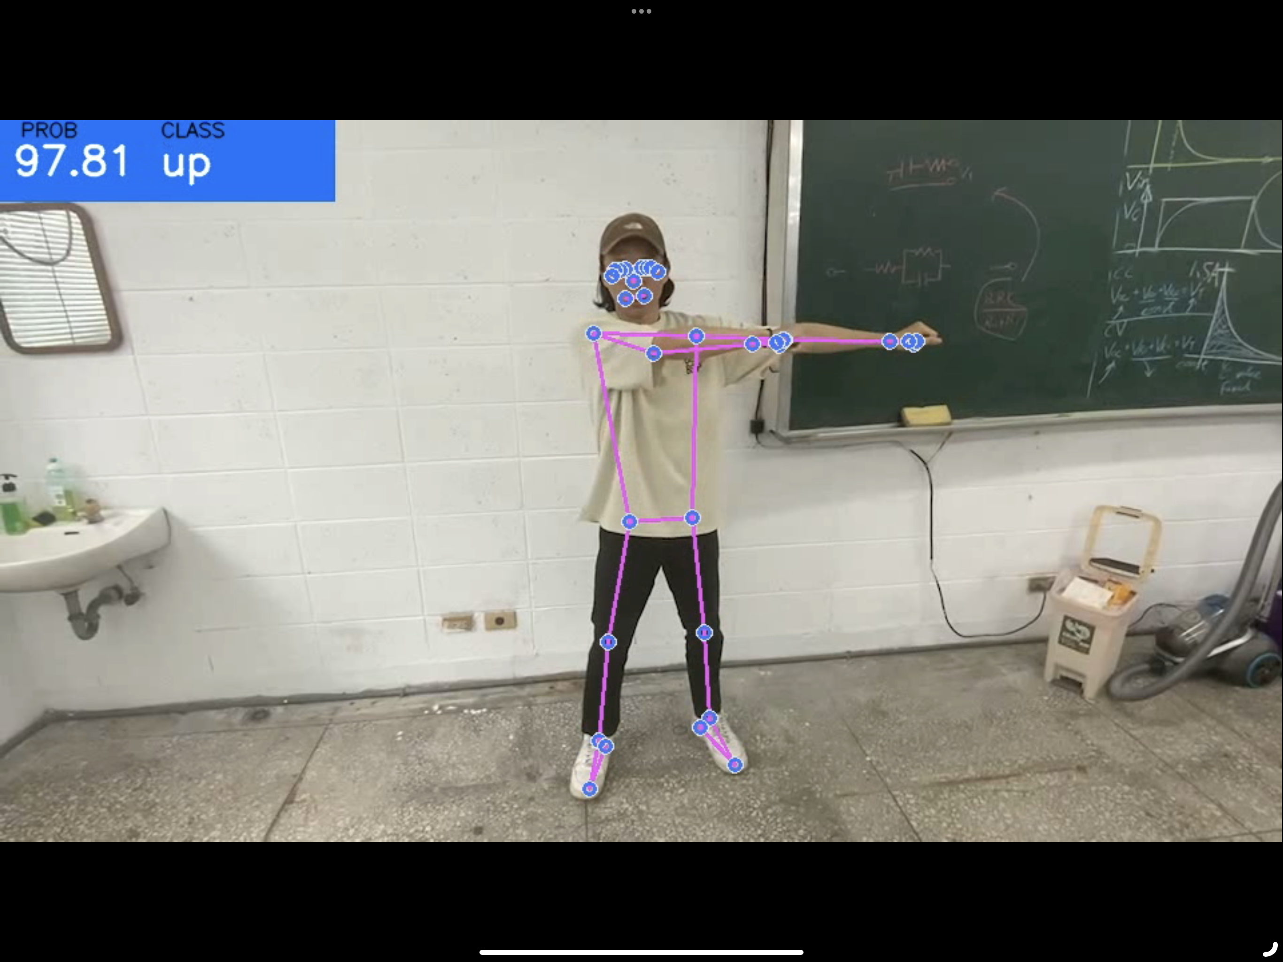
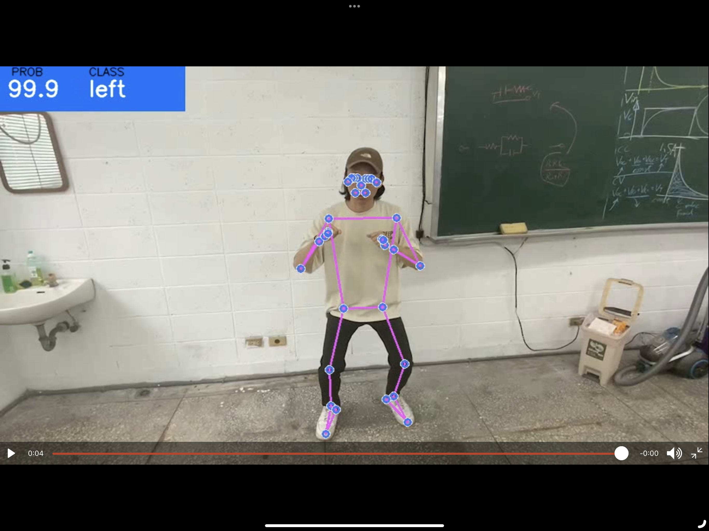
Problems

Slide 21
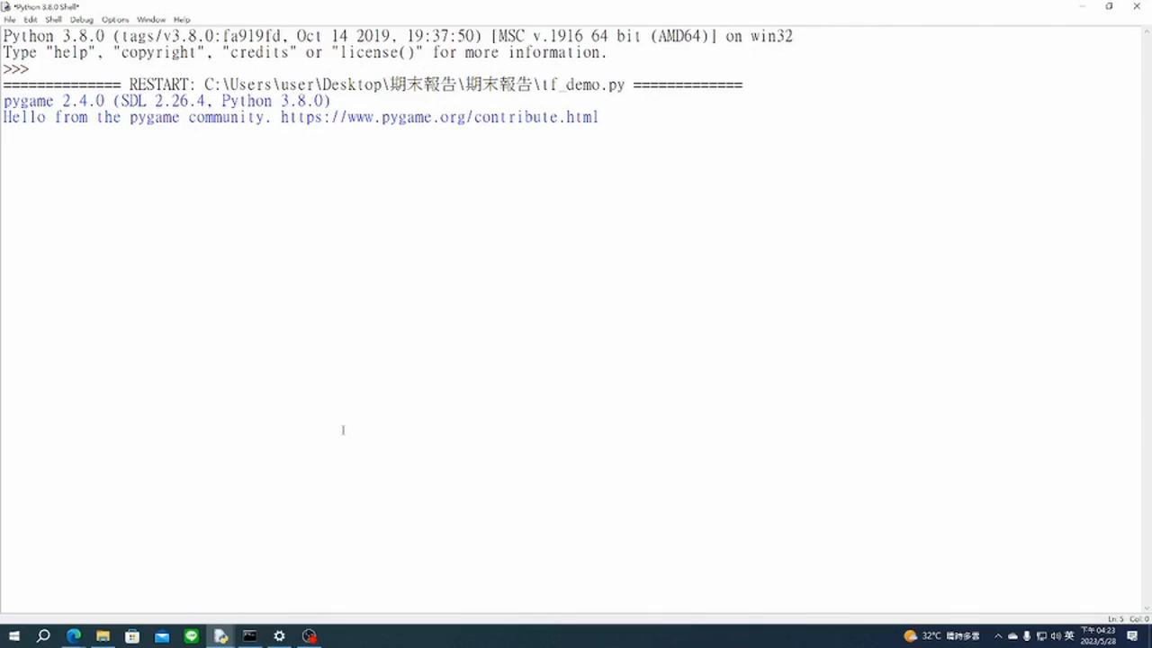
Result (MLP)

Slide 22

Thanks!

